Slide 1

Final Project on
ONLINE SHOPPING CART APPLICATION
EDUBRIDGEINDIA LEARNING PVT. LTD.
Batch: 2020 – 5733
Center: Pune
Presented by :-
Pratibha Walunj
Swapnali Kore
Mrunali Newarekar
Under the Guidance of :-
Prof. Jayanth V. (Technical Trainer)

Slide 2

AGENDA
ABSTRACT
OBJECTIVE
PROBLEM STATEMENT
PROJECT PLANNING(SDLC)
APPLICATIONS
IMPLEMENTATION DETAILS
SREENSHOTS
RESULT
CONCLUSION

Slide 3


ABSTRACT
The Online Shopping is a web based application intended for online retailers. The main objective of this application is to make it interactive and its ease of use. It would make searching, viewing and selection of a product easier.
The application also provides a drag and drop feature so that a user can add a product to the shopping cart by dragging the item in to the shopping cart.

Slide 4

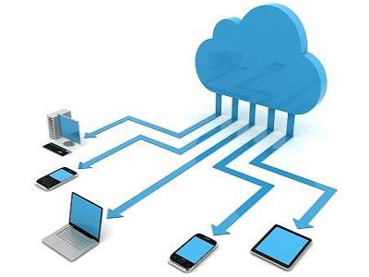
OBJECTIVE
Online shopping is a form of electronic commerce which allows consumers to directly buy goods or services from a seller over the Internet using a web browser. Consumers find a product of interest by visiting the website of the retailer directly or by searching among alternative vendors using a shopping search engine, which displays the same product's availability and pricing at different e-retailers.
Our Project Include Modules:-
A)Admin Module
B)Customer Module
C)Cart Module

Slide 5
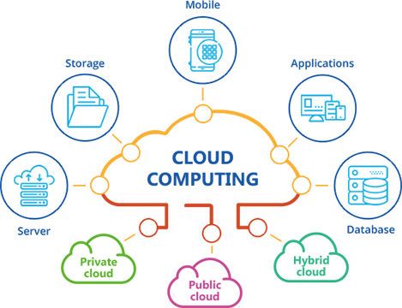
PROBLEM STATEMENT
This projects aims to develop an online shopping for customers with the goal so that it is very easy to shop your loved things from a extensive number of online shopping sites available on the web. With the help of this you can carry out an online shopping from your home.
Here is no compelling reason to go to the crowed stores or shopping centers during festival seasons. You simply require a PC or a laptop and one important payment sending option to shop online.

Slide 6
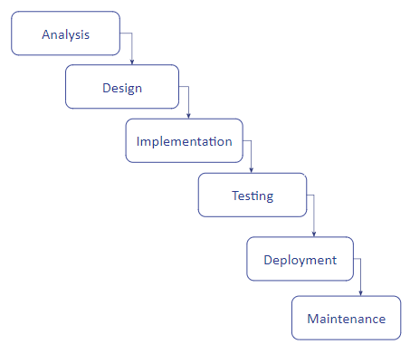
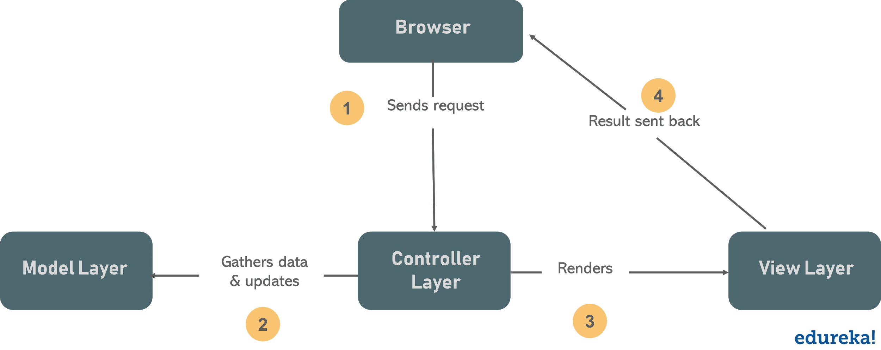
PROJECT PLANNING(SDLC)

Slide 7
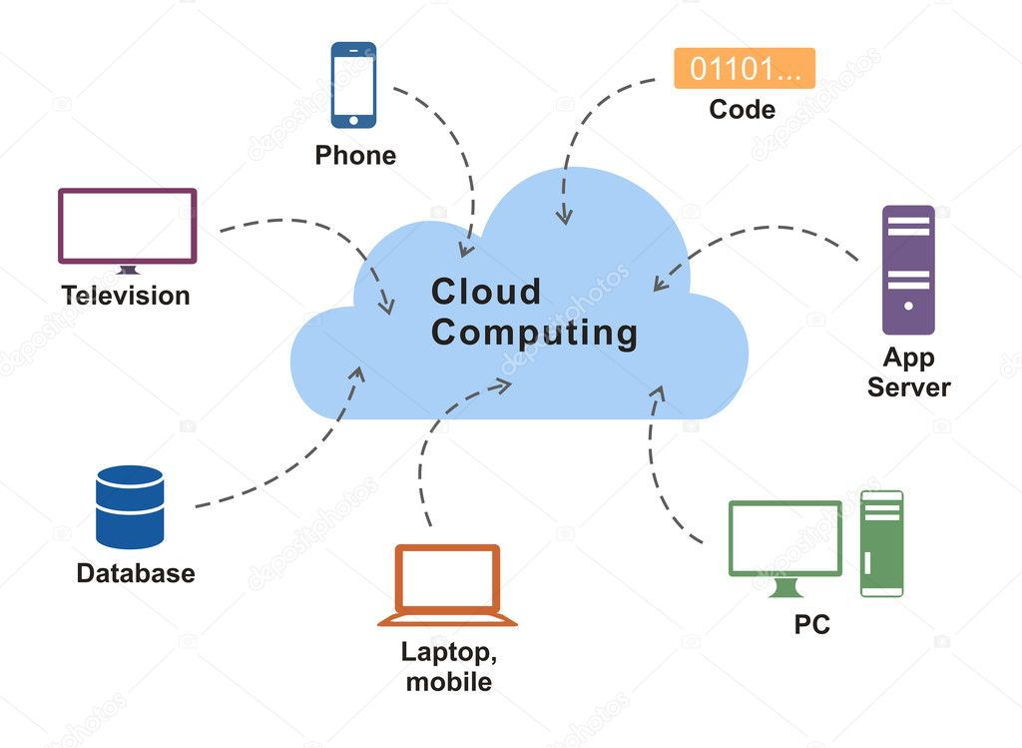
APPLICATIONS
Applications of Online Shopping Cart Application:
Shopping cart software is a piece of e-commerce software on a web server
Reduce abandoned carts and increase average order values with intelligent onsite messaging.
Customer database management system.

Slide 8





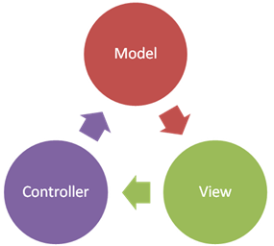


IMPLEMENTATION DETAILS
Software Requirements:-
Operating system: Windows 8,10
Front end : HTML,CSS.JSP
Backend: SQL, JAVA
Architecture: MVC Architecture
Editor: Eclipse
Server: Apache Tomcat 8.5
Hardware Requirements:-
Random Access Memory (RAM): 4/8 GB
Device: Laptop or Computer, Android Phone

Slide 9
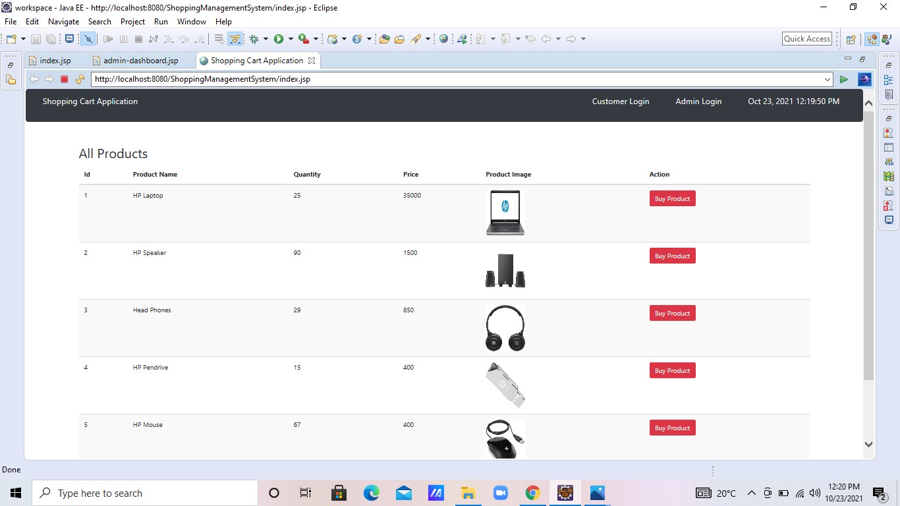

Slide 10
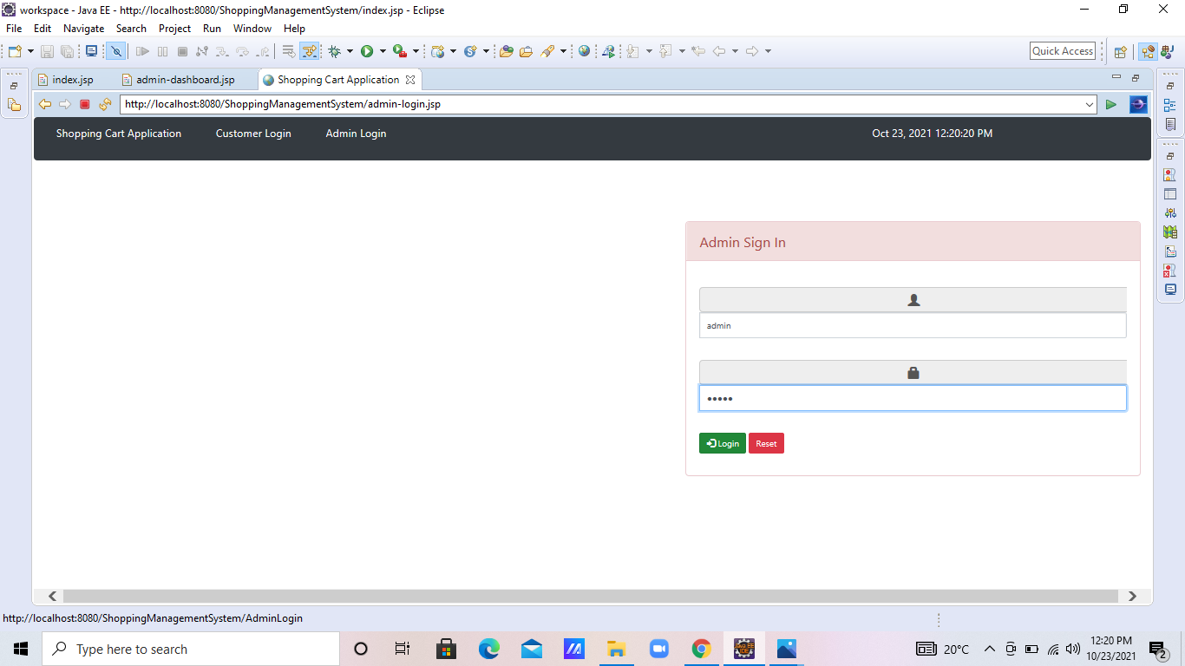

Slide 11
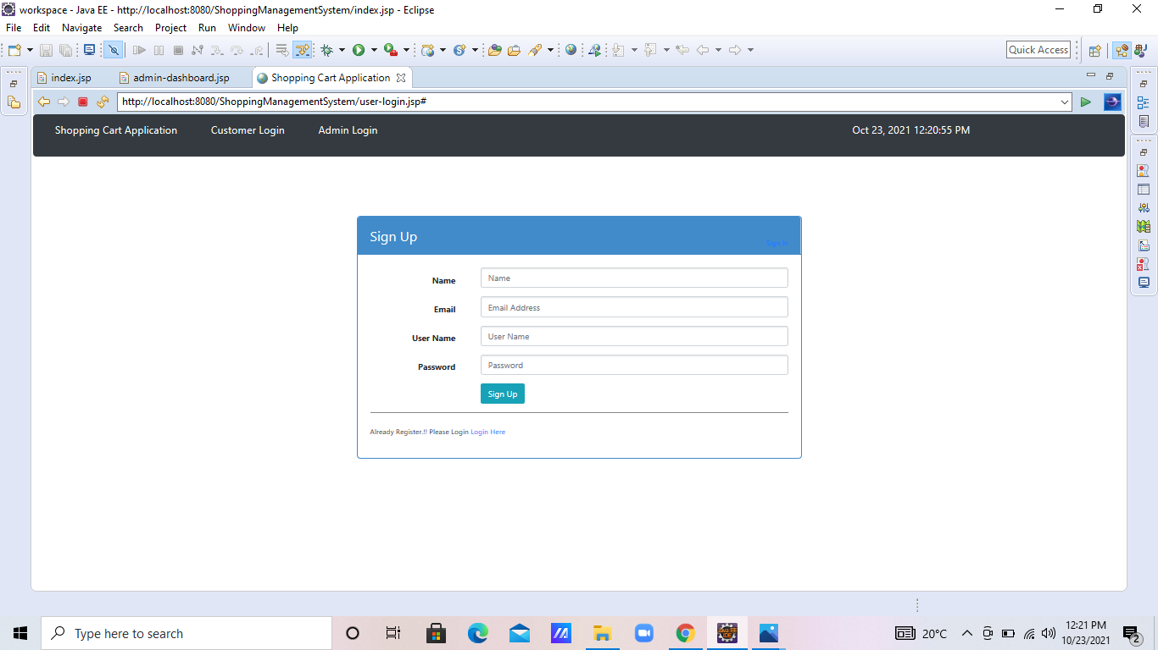

Slide 12
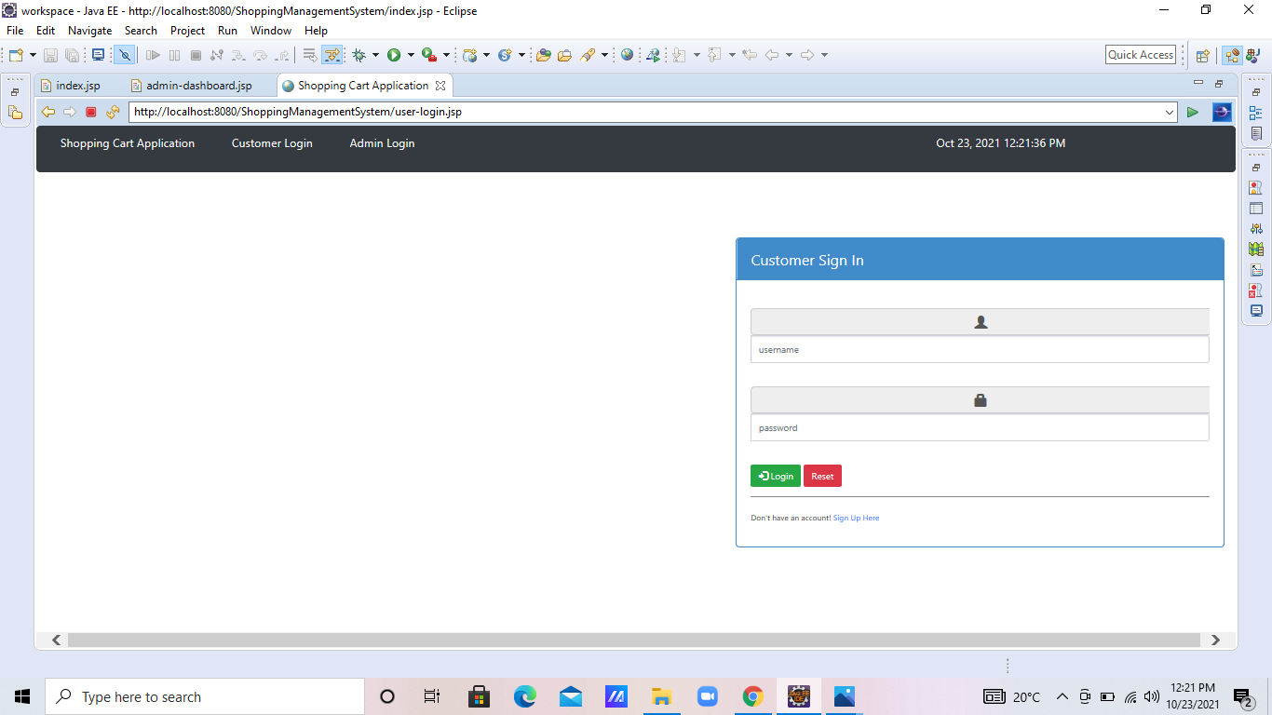

Slide 13
RESULT
The application can be used for any Ecommerce application. It is easy to use, since it uses the GUI provided in the user dialog. User friendly screens are provided. The application is easy to use and interactive making online shopping a recreational activity for users. It has been thoroughly tested and implemented.
The overall idea of doing this project is to get a real time experience. Learn new technologies.

Slide 14
CONCLUSION
A shopping cart on an online retailer's site is a piece of software that facilitates the purchase of a product or service. It accepts the customer's payment and organizes the distribution of that information to the merchant, payment processor and other parties.
Shopping carts bridge the gap between shopping and buying, so having the best shopping cart software is extremely important on your website.
EdubridgeIndia Learning Pvt. Ltd.

Slide 15

THANK YOU…!
Any Questions.

